Slide 1

Session 1

Slide 2
Topics covered in Session 1
Introduction
Python Basics
Python Data Variables & Operators
Data Variables and its types
Operators
id() and type() functions
Coding Standards
Control Structures
If else
elif, Nested if
Iteration Control Structures
Break, Continue & Pass

Slide 3
Why Python for beginners?
Easy – to - learn
Code is 3-5 times shorter than Java
5-10 times shorter than C++
Stepping Stone to Programming universe
Python’s methodologies can be used in a broad range of applications
Bridging the Gap between abstract computing and real world applications
Python is used as main programming language to do projects using Raspberry Pi
Rising Demand for Python Programmers
Google, Nokia, Disney, Yahoo, IBM use Python
Open- Source, Object – Oriented, procedural and functional
Not only a Scripting language, also supports Web Development and Database Connectivity

Slide 4
Python v/s Java
A simple Program to print “Hello World”
Java Code | Python Code
public class HelloWorld { public static void main(String args [] ) { System.out.println (“Hello World!”) } } | print (“Hello World!”)

Slide 5
Worldwide Python Users
Web Development
Yahoo Groups, Google, Shopzilla
Games
Battelefield2, The Temple of Elemental Evil, Vampire
Graphics
Walt Disney feature Animation, Blender 3D
Science
National Weather Service
NASA
Environmental Systems Research Institute

Slide 6
Evolution of Python
Guido Van Rossum developed Python in early 1990s at National Research
Institute for Mathematics and Computer Science, Netherlands.
Named after a circus show Monty Python show.
Derives its features from many languages like Java, C++, ABC, C, Modula-3, Smalltalk, Algol-68, Unix shell and other scripting languages.
Available under the GNU General Public License (GPL) – Free and open-source software.

Slide 7
Python Versions
Python v0.9.0 - February, 1991
Features: Exception Handling, Functions and core data types like List, Dictionary, String and others. It was object oriented and had module system
Python v1.0 - January 1994
Features: Functional Programming tools lambda, map, filter and reduce
Python v2.0 - October 2000
Features: List comprehensions, Garbage Collector and support for Unicode.
Python v3.0 - 2008
Known as “Python 3000” and “Py3k”. It is not backward compatible with v2.0 and its other variants. Emphasizes more on removal of duplicate programming constructs and modules

Slide 8
Python Features
Python is a High - Level, Interpreted, Interactive and Object - Oriented Programming Language
Features include:
Beginners Language
Extensive Standard Library
Cross Platform Compatibility
Interactive Mode
Portable and Extendable
Databases and GUI Programming
Scalable and Dynamic Semantics
Automatic Garbage Collection

Slide 9
Commenting Style in Python!
Types of Comments:
A single line comment starts with hash symbol ‘#’ and end as the line ends.
These lines are never executed and are ignored by the interpreter.
Single ➔ # This is a single line comment
Multi-line comments starts and ends with triple single quotes ‘’’ or triple “””
double quotes
Used for documentation
Triple ➔ ‘’’ or “””
“””
Contents here can be used for documentation
“””
‘’’
An example for multi-line comments with single quotes ‘’’

Slide 10
Multiline statements
Python statements always end up with a new line, but it also allows multiline statement using “\” character at the end of line as shown below:
result = (8+5)*\
2+\
9/5
Statements which have (), [], {} brackets and comma, do not need any multiline character to go to next line.
customer_details = [101, ‘kevin’,
‘165’, 498.24]

Slide 11
Print Statement
Displays the output on the screen of user
Python has its own String Format Operator as %
print('The value of PI is %5.3f' % 3.1417)
print('The value of PI is approximately %5.2f.' % 3.1417) print( "Latest Python Version is: %d" % 3.5)
print ("%20s : %d" % ('Python', 3000.34 ))
Output:
The value of PI is 3.142
The value of PI is approximately 3.14. Latest Python Version is: 3
Python : 3000
https://py3.codeskulptor.org/#user305_TJ8NdBLDjCECBYY.py
User Input in Python
name = input("Enter your name")
print("Welcome to session on Programming in Python,", name)
Guided Activity: Assignment 1: Using Eclipse IDE to create and execute Python Program

Slide 12

Execute a Python Script
Execution of python program means execution of the byte code on Python Virtual Machine
print(“Hello World!”)
print("My first sample python script")
#prints Hello World!
#prints My first sample python script
Virtual Machine
Source Code
Byte Code
PVM

Slide 13
Programming Constructs in Python
Guided Activity: Programming constructs in Python - Assignment 2
Given a real world problem, to solve the problem using a program, we need:
Logic
High level programming language
Programming Fundamentals
Identifiers
Variables
Data types
Operators etc

Slide 14

Identifiers
Are names given to anything that you want to identify in a program
Helps to refer to that item from any place in the program
Can start with an underscore (_) or a upper or lower case alphabet
Can have digits
Identifiers cannot match any of Python's reserved words
Are case-sensitive
Identify the identifiers needed to solve the
bill_id customer_id bill_amount
problem discussed as part of previous guided activity?

Slide 15
Variables
An identifier for the data and it holds data in your program
Is a location (or set of locations) in memory where a value can be stored
A quantity that can change during program execution
No declaration of variables
Data type of a variable can change during program execution compared to other strongly typed languages such as Java, C++, C
customer_id = 101 customer_name = "John" bill_amount = 675.45
x = 5.3 + 0.9j
print(customer_id, customer_name, bill_amount) print(x.real)
print(x.imag + 3)
# Integer # String
# Floating-point
# complex number #prints 101 John 675.45
#prints 5.3
#prints 3.9
https://py3.codeskulptor.org/ - user305_z81riiBDOH6ACR2.py

Slide 16
Data Types in Python
Category | Data Type | Example
Integer Type | int | 675
 | long | 9669737712
 | complex | 2 + 5i
Floating Type | float | 642.43
Textual | char | C
 | String | Infosys
Logical | boolean | True, False
We will now understand different types of operators and how to write a simple program
Guided Activity: Programming constructs in Python – Assignment 1

Slide 17
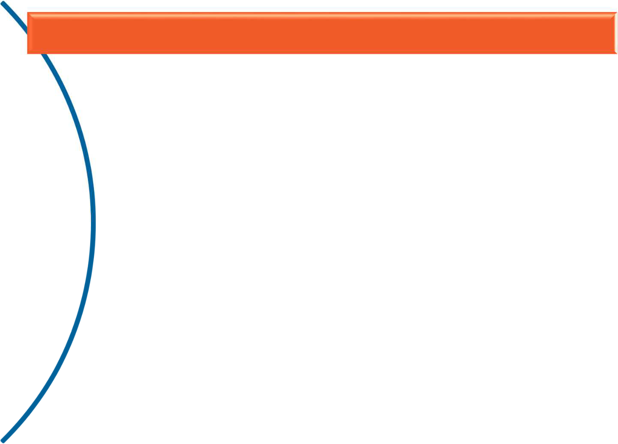



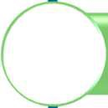



Operators (1 of 7)
Used to perform specific operations on one or more operands (or variables) and provide a result
Arithmetic Operators Relational Operators
Assignment Operators Bitwise Operators
Logical Operators Membership Operators
Identity Operators

Slide 18
Operators (2 of 7)
Arithmetic Operators
– Used for performing arithmetic operations
Operators | Description | Example
+ | Additive operator (also used for String concatenation) | 2 + 3 = 5
- | Subtraction operator | 5 – 3 = 2
* | Multiplication operator | 5 * 3 = 15
/ | Division operator | 6 / 2 = 3
% | Modulus operator | 7 % 2 = 1
// | Truncation division (also known as floor division) | 10 // 3 = 3 10.0 // 3 = 3.0
** | Exponentiation | 10 ** 3 = 1000
https://py3.codeskulptor.org/#user305_z81riiBDOH6ACR2.py

Slide 19
Operators (3 of 7)
Relational Operators
Also known as Comparison operators
Used in conditional statements to compare values and take action depending on the result
Operators | Description
== | Equal to
< | Less than
> | Greater than
<= | Lesser than or equal to
>= | Greater than or equal to
!= | Not equal to
<> | Similar to Not equal to
https://py3.codeskulptor.org/#user305_MjVHyOyo27Mkr5y.py

Slide 20
Operators (4 of 7)
Assignment Operators
Operators | Description | Example | Equivalent
= | Assignment from right side operand to left side | c = 50; c = a;
+= | Add & assigns result to left operand | c += a | c = c + a
-= | Subtract & assigns result to left operand | c -= a | c = c – a
*= | Multiply & assigns result to left operand | c *= a | c = c * a
/= | Divide & assigns result to left operand | c /= a | c = c / a
%= | Calculates remainder & assigns result to left operand | c %= a | c = c % a
//= | Performs floor division & assigns result to left operand | c //= a | c = c // a
**= | Performs exponential calculation & assigns result to left operand | c **= a | c = c ** a
Multiple Assignments – Same value can be assigned to more than one variable
Ex.1: Students Ram, Sham, John belong to semester 6 Ram = Sham = John = 6
Ex.2: a, b, c = 10, 20, 30 is same as a = 10, b = 20, c = 30

Slide 21
Operators (5 of 7)
Bitwise Operators
– performs bit by bit operation on bits
Operators | Description
& | Binary AND
| | Binary OR
^ | Binary XOR
~ | Binary Ones Complement
<< | Binary Left Shift
>> | Binary Right Shift

Slide 22
Operators (6 of 7)
Logical Operators
Are based on Boolean Algebra
Returns result as either True or False
Operator | Meaning
and | Short Circuit-AND
or | Short Circuit-OR
not | Unary NOT
Demo: Assignment 5: Programming constructs in Python
Guided Activity: Assignment 6, 7, 8: Programming constructs in Python

Slide 23
Operators (7 of 7)
Membership Operators
– Checks for membership in a sequence of Strings, Lists, Dictionaries or Tuples
Operators | Description
in | Returns to true if it finds a variable in given sequence else false
not in | Returns to true if it does not find a variable in given sequence else false
Identity Operators
– Are used to compare memory locations of 2 objects
Operators | Description
is | Returns to true if variables on either side of operator are referring to same object else false
is not | Returns to false if variables on either side of operator are referring to same object else true

Slide 24
Built-in function: id()
Id(object)
Returns identity of an object. It is the address of object in memory
It will be unique and constant throughout the lifetime of an object
Example:
Output
a = 10
b = a
print("Value of a and b before increment") print("id of a: ",id(a))
print("id of b: ",id(b)) b = a + 1
print("Value of a and b after increment") print("id of a: ",id(a))
print("id of b: ",id(b))
Value of a and b before increment
id of a: 1815592664
id of b: 1815592664
Value of a and b after increment
id of a: 1815592664
id of b: 1815592680
Note the change in address of variable ‘b’ after increment

Slide 25
Built-in function: type()
Used to identify the type of object
Example:
int_a = 10
print("Type of 'int_a':", type(int_a))
str_b = "Hello"
print("Type of 'str_b':", type(str_b))
list_c = []
print("Type of 'list_c':", type(list_c))
Output:
Type of 'int_a': <class 'int'>
Type of 'str_b': <class 'str'> Type of 'list_c': <class 'list'>
Note: Every variable in Python is a object
Guided Activity: Assignment 9: id() and type() functions - Quiz

Slide 26
Coding Standards in Python
Set of guidelines
To Enhance the readability and Clarity of the program
Make it easy to debug and maintain the program
All the letters in a variable name should be in lowercase
When there are more than two words in variable name, underscore can be used between internal words
Use meaningful names for variables
Limit all lines to a maximum of 79 characters
A function and class should be separated by 2 blank lines
Methods within classes should be separated by single blank line
Always surround binary operators with a space on either side:
Ex: a = a + 1;

Slide 27
Coding Standards in Python
Bad Code | Good Code
a = 10 b = 23 C = 24 ^{sum = a + b + c} ^{avg = sum/3} print(“Average: “, avg) | marks1 = 10 marks2 = 23 marks3 = 24 sum_of_marks = marks1 + marks2 + marks3 avg_of_marks = sum_of_marks / 3 print (“Average: “, avg_of_marks)
Guided Activity: Assignment 10: Coding Standards

Slide 28

Indentation in Python
Python uses offside rule notation for coding
Uses indentation for blocks, instead of curly brackets
The delimiter followed in Python is a colon (:) and indented spaces or tabs.
Example:
x = 3
if x > 5:
print("true") print(x)
else:
print ("false") print ("Out of if block")
Block 1
Block 2
Block 3
Block 2, Continuation
Block 3, Continuation
1st level indent ➔ if block
2nd level indent ➔statements within if or else block

Slide 29
Control Structures
Guided Activity: Assignment 11: Control Structures
Decision making statements
– if statement:
if statement checks for a condition and if that is found true a particular set of instructions gets executed
Example:
Syntax:
x = 8
if x < 10:
print("Value of x is %d" %x) var = 10
if var > 5:
print ("Hi") # line belongs to if block print("I'm out of if")
if condition1:
statement(s)
else:
statement(s)
Output:
Predict the output of this code snippet when value of x = 15?
Value of x is 8 Hi
I'm out of if
https://py3.codeskulptor.org/ - user305_VIjfvwVGaIG9B6k.py

Slide 30
Control Structures…
Demo: Assignment 12: Control Structures
elif statement:
– elif statement is used when there is more than one condition to be checked separately
Example:
Syntax:
if condition1:
statement(s)
elif condition2:
statement(s)
else:
statement(s)
var=10
if var > 10 : print("Hello") print(var)
elif var < 10:
print("Hola in Spanish for Hello") print(var)
else:
print("Hi") print(var)
print("End of Program")
Output:
Hi 10
End of Program
Note: There is no switch case statement in Python unlike C/C++ language
Guided Activity: Assignment 13, 14, 15, 16: Control Structures
https://py3.codeskulptor.org/#user305_KFMGy26VbiD3LDy.py

Slide 31
Iterative Statements
Loop statements:
Allows us to execute a statement or group of statements multiple times.
While Loop
For Loop
Range
Loop Control Statements:
Are used to change flow of execution from its normal sequence.
Break
Continue
Pass

Slide 32
Iterative Statements
while loop:
Repeats a statement or group of statements while a given condition is TRUE.
Tests the condition before executing the loop body.
Syntax:
while condition:
statement(s)
Example:
n = 5
result = 0
counter = 1
while counter <= n:
result = result + counter counter += 1
print("Sum of 1 until %d: %d" % (n, result))
Output:
Sum of 1 until 5: 15
https://py3.codeskulptor.org/ - user305_fXoC8y9pPJk9heg.py
https://py3.codeskulptor.org/ - user305_MjVHyOyo27Mkr5y.py

Slide 33
Iterative Statements
for loop:
Executes a sequence of statements multiple times and abbreviates the code that manages the loop variable.
Syntax:
for iterating_var in sequence: statement(s)
Output:
1
2
Sita 7
Ram 5
Example:
for counter in 1,2,'Sita', 7,'Ram',5: print(counter)
https://py3.codeskulptor.org/#user305_IMrMmRWaLp5eRXB.py
https://py3.codeskulptor.org/ - user305_Gwmn3gkWe9AOwCs.py

Slide 34
Iterative Statements
range function in loops
Used in case the need is to iterate over a specific number of times within a given range in steps/intervals mentioned
Syntax:
range(lower limit, upper limit, Increment/decrement by)
Loop | Output | Remarks
for value in range(1,6): print(value) | 1 2 3 4 5 | Prints all the values in given range exclusive of upper limit
for value in range(0,6,2): print(value) | 0 2 4 | Prints values in given range in increments of 2
for value in range(6,1,-2): print(value) | 6 4 2 | Prints values in given range in decrements of 2
for ch in "Hello World": print(ch.upper()) | H E L L O W O R L D | Prints all the characters in the string converting them to upper case
Guided Activity: Assignment 17: Control Structures
https://py3.codeskulptor.org/#user305_5HsEgm7K53vFfGY.py

Slide 35
Iterative Statements- break
Loop Control Statements - break and continue
When an external condition is triggered, Exits a loop immediately.
Break Statement:
– Terminates the loop statement and transfers execution to the statement immediately following the loop.
Example:
var = 3
while var > 0:
print ("I'm in iteration ",var) var -= 1
if var == 2: break
print ("I'm still in while") print ("I'm out of while loop")
Output:
I'm in iteration 3 I'm out of while loop
Observe the output of this code snippet when value of var = 5?
Demo: Assignment 18: break statement
https://py3.codeskulptor.org/#user305_z0JE29YV7idHkFh.py

Slide 36
Iterative Statements - continue
continue statement:
Causes the loop to skip the remainder of its body and immediately retest its condition prior to reiterating.
Example:
var = 3
while var > 0:
print ("I'm in iteration ", var) var -= 1
if var == 2: continue
print ("I'm still in if block") print ("I'm still in while")
print ("I'm out of while loop")
Output:
I'm in iteration 3 I'm in iteration 2 I'm still in while I'm in iteration 1 I'm still in while
I'm out of while loop
Demo: Assignment 19: continue statement
Guided Activity: Assignment 20: Iteration Control Structure - Debugging
https://py3.codeskulptor.org/ - user305_C2yQQn9CP0GyzUW.py

Slide 37
Iterative Statements- pass
pass statement:
pass statement is never executed.
Used when a statement is required syntactically but do not want any command or code to execute or if the code need to be implemented in future.
Behaves like a placeholder for future code
Example:
x = "Joy"
if x == "John":
print ("Name:",x) elif x == "Joy":
pass else:
print ("in else")
Output:
No Output

